Slide 1
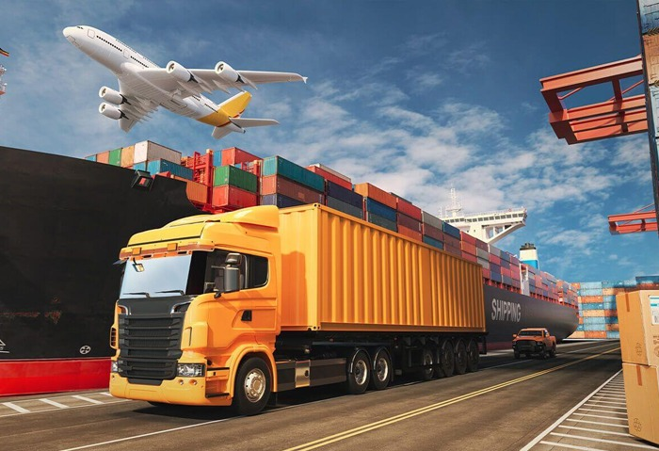


ABOUT PROJECT
BUSINESS QUESTIONS
METHODOLOGY
TOOLS & TECHNOLOGIES
INSIGHTS
Trans-border
Freight Transportation & Emissions Analysis (2021–2024)
(Uncovering Patterns, Inefficiencies & Environmental Impact)
Presented by: Juliet Fafali Kukuia (Data Analyst)
Organization: getINNOtized | Bureau of Transportation Statistics

Slide 2
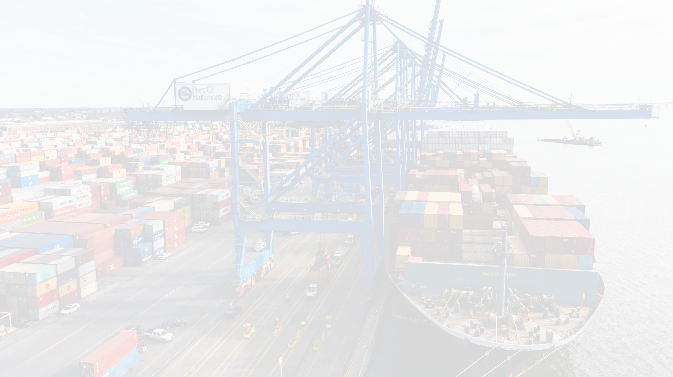
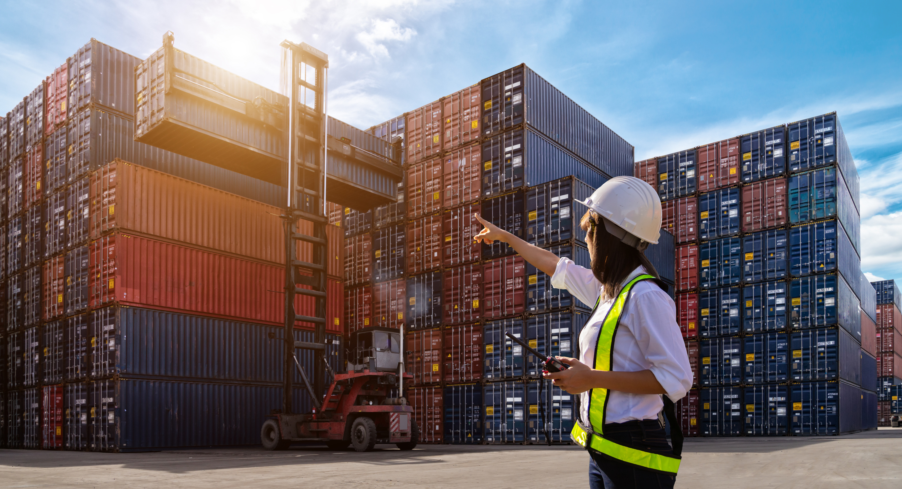
ABOUT PROJECT
BUSINESS QUESTIONS
METHODOLOGY
TOOLS & TECHNOLOGIES
INSIGHTS
About
The Project
This project analyzes U.S. freight transportation data (2021–2024) to uncover inefficiencies and environmental impacts in national logistics systems using the CRISP-DM framework and Power BI. Focused on freight volume, economic value, emissions, transport modes, and containerization to identify inefficiencies and support sustainable logistics decision-making.

Slide 3

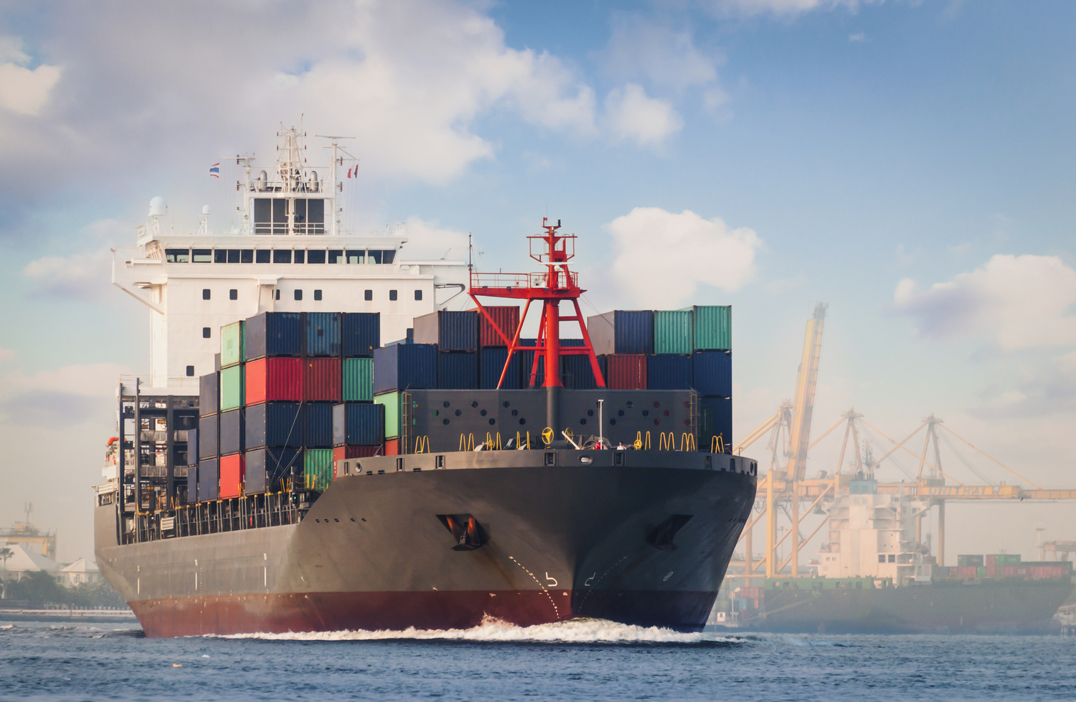

ABOUT PROJECT
BUSINESS QUESTIONS
METHODOLOGY
TOOLS & TECHNOLOGIES
INSIGHTS
Which transportation modes account for the highest freight volume and value?
What is the monthly distribution of freight-related carbon emissions?
Is there a correlation between freight volume, value, and emissions?
How does containerization affect efficiency and shipping charges?
Which commodities contribute most to CO₂ emissions?
Business
Shipment Process

Slide 4
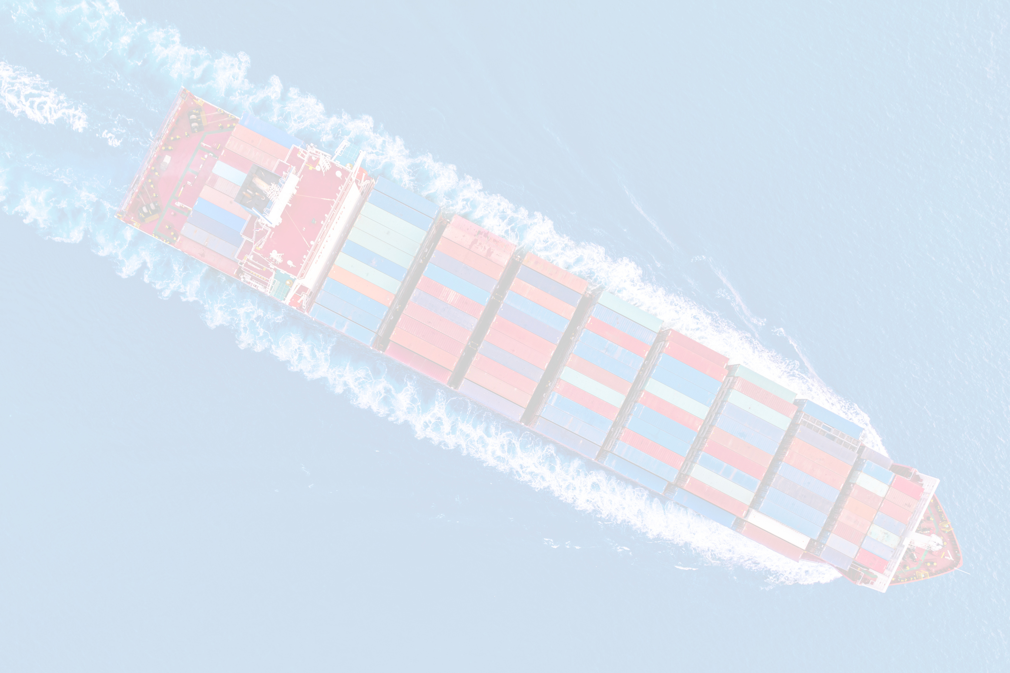
ABOUT PROJECT
BUSINESS QUESTIONS
METHODOLOGY
TOOLS & TECHNOLOGIES
INSIGHTS
Business Understanding
Defined key questions with the BTS
Data Understanding
Explored multi-year BTS freight data (2021–2024)
Data Preparation
Merged files, cleaned columns in Python, created new fields (e.g., emissions, shipment ID)
Modeling
Created DAX measures, KPIs, and custom calculations (freight charge per commodity, total emissions, etc.)
Evaluation
Identified high-emission modes, low-efficiency lanes, seasonal bottlenecks
Methodology
CRISP-DM Approach

Slide 5
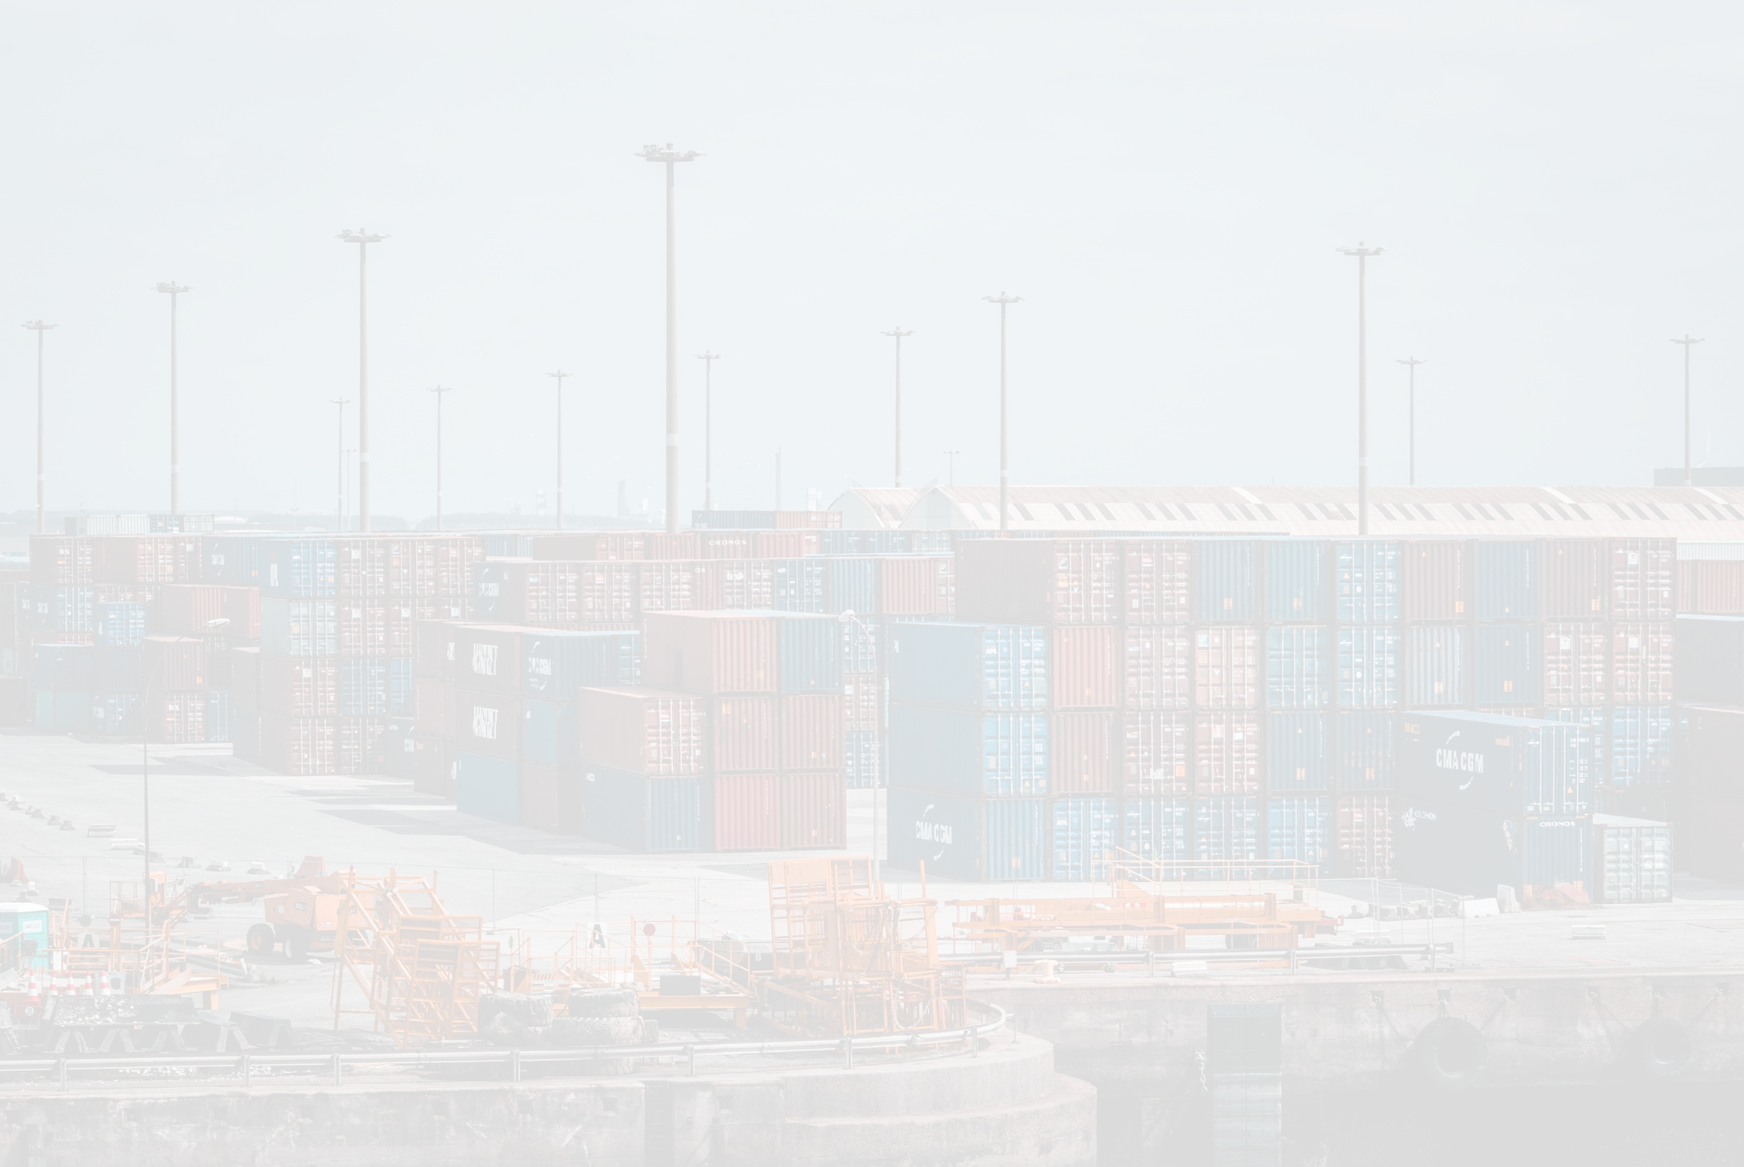
ABOUT PROJECT
BUSINESS QUESTIONS
METHODOLOGY
TOOLS & TECHNOLOGIES
INSIGHTS
Tools
Python – For initial EDA or emissions estimation
Power BI – Data modeling, DAX, dashboard creation
Power Query – Data transformation & custom column creation
GitHub – Version control and project documentation
CRISP-DM – Structured project execution
& Technologies

Slide 6
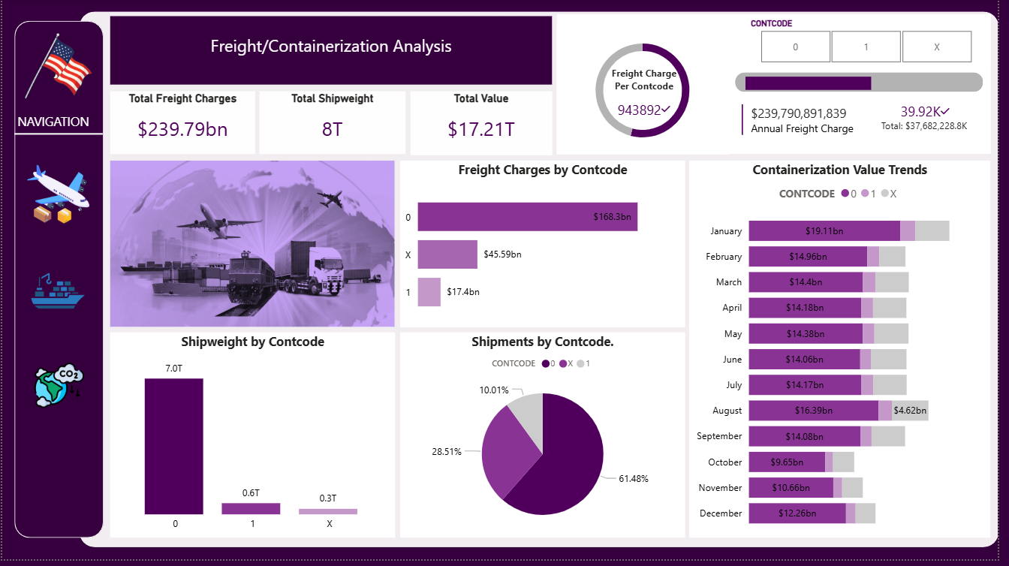
ABOUT PROJECT
BUSINESS QUESTIONS
METHODOLOGY
TOOLS & TECHNOLOGIES
INSIGHTS
Containerization Report
Notes:
The dashboard shows that most shipments (61.5%) are non-containerised (Code 0), accounting for the highest freight charges ($168.3bn) and weight (7T). Container codes 1 and X represent a smaller share of charges and weight. Monthly trends show stable values with slight peaks in July and September. Overall, the data suggests a heavy reliance on bulk shipping and limited container use, indicating room for improved containerisation and cost efficiency.

Slide 7
ABOUT PROJECT
BUSINESS QUESTIONS
METHODOLOGY
TOOLS & TECHNOLOGIES
INSIGHTS
Most shipments (61.5%) are non-containerised (Code 0), accounting for the highest freight charges ($168.3bn) and weight (7T).
Container codes 1 and X represent a smaller share of charges and weight.
Monthly trends show stable values with slight peaks in July and September..
Insights
Containerization Report
Notes:
The dashboard shows that most shipments (61.5%) are non-containerised (Code 0), accounting for the highest freight charges ($168.3bn) and weight (7T). Container codes 1 and X represent a smaller share of charges and weight. Monthly trends show stable values with slight peaks in July and September. Overall, the data suggests a heavy reliance on bulk shipping and limited container use, indicating room for improved containerisation and cost efficiency.

Slide 8
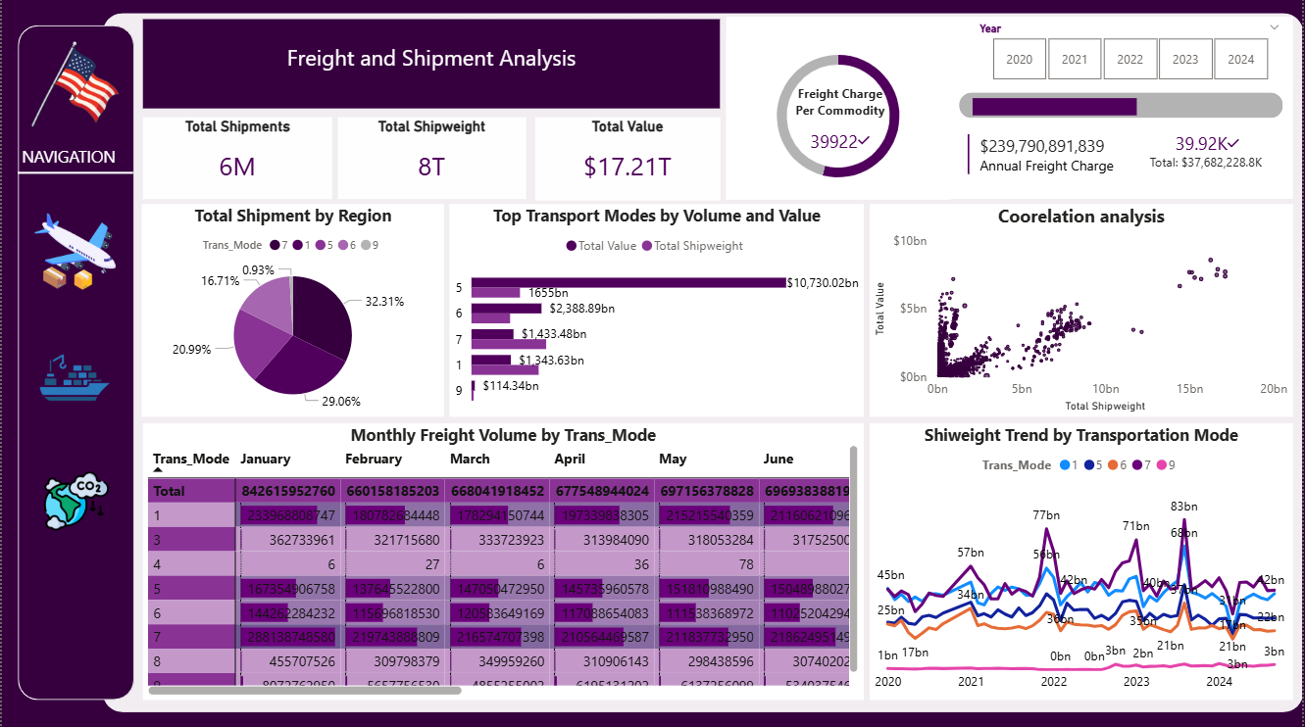
ABOUT PROJECT
BUSINESS QUESTIONS
METHODOLOGY
TOOLS & TECHNOLOGIES
INSIGHTS
Notes:
The dashboard presents a comprehensive view of transborder freight activity. A total of 6 million shipments weighing 8 trillion tonnes generated $17.21 trillion in value. Regionally, the highest freight activity is concentrated in zones coded 6 (32.31%) and 5 (29.06%).Transport mode 5 dominated both in volume (1,655bn tonnes) and value ($10.73tn), followed by modes 6 and 7. Freight charges per commodity averaged 39,922, with total freight charges reaching $239.79bn. Correlation analysis shows a strong positive relationship between shipweight and freight value, while time series trends reveal peak freight activity in 2023 across most transport modes.

Slide 9
ABOUT PROJECT
BUSINESS QUESTIONS
METHODOLOGY
TOOLS & TECHNOLOGIES
INSIGHTS
A total of 6 million shipments weighing 8 trillion tonnes generated $17.21 trillion in value.
Regionally, the highest freight activity is concentrated in zones coded 6 (32.31%) and 5 (29.06%).
Transport mode 5 dominated both in volume (1,655bn tonnes) and value ($10.73tn), followed by modes 6 and 7.
Freight charges per commodity averaged $39,922 with total freight charges reaching $239.79bn.
A strong positive relationship between shipweight and freight value
Time series trends reveal peak freight activity in 2023 across most transport modes.
Insights
Freight and Shipment Report
Notes:
The dashboard presents a comprehensive view of transborder freight activity. A total of 6 million shipments weighing 8 trillion tonnes generated $17.21 trillion in value. Regionally, the highest freight activity is concentrated in zones coded 6 (32.31%) and 5 (29.06%).Transport mode 5 dominated both in volume (1,655bn tonnes) and value ($10.73tn), followed by modes 6 and 7. Freight charges per commodity averaged 39,922, with total freight charges reaching $239.79bn. Correlation analysis shows a strong positive relationship between shipweight and freight value, while time series trends reveal peak freight activity in 2023 across most transport modes.

Slide 10
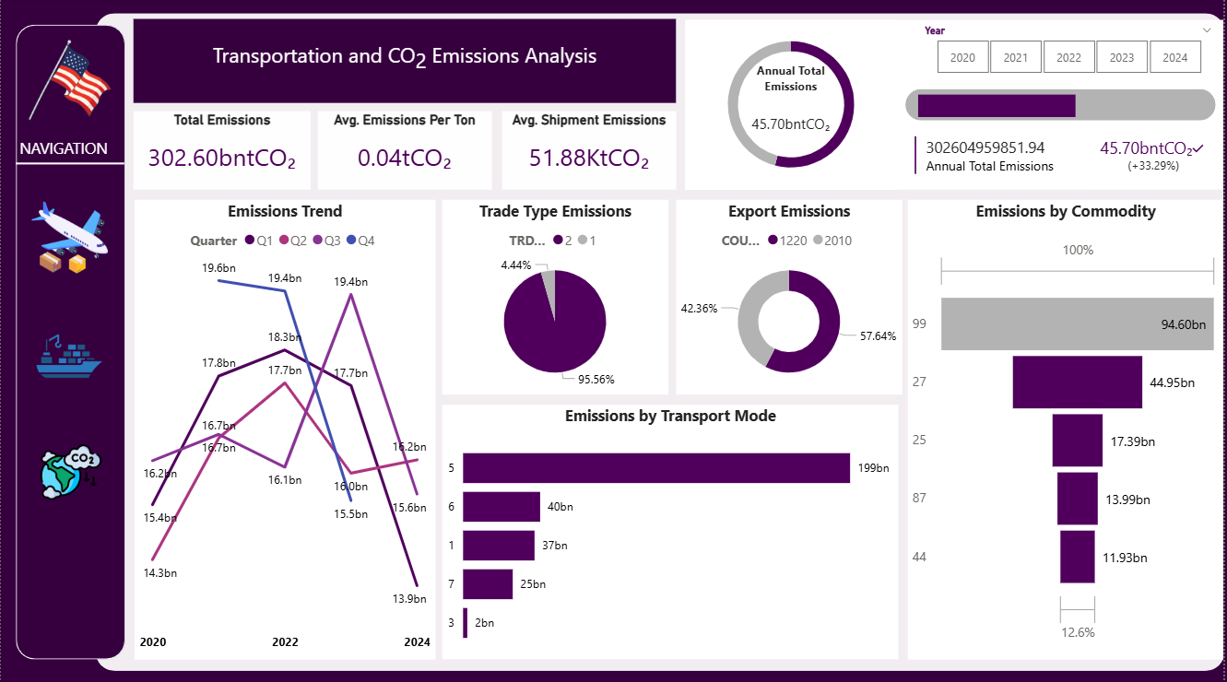
ABOUT PROJECT
BUSINESS QUESTIONS
METHODOLOGY
TOOLS & TECHNOLOGIES
INSIGHTS
Notes:
The dashboard captures total emissions of 302.60 billion tonnes CO₂, with an average of 0.04tCO₂ per tonne of freight and 51.88KtCO₂ per shipment. The latest annual emissions stand at 45.70 billion tonnes CO₂, showing a 33.29% increase relative to the 68.5bn target. Quarterly emissions peaked in 2020 (Q3: 19.6bn) and have generally declined through to 2024 (Q4: 11.9bn). Export trade accounted for 57.64% of total emissions, while transport mode 5 alone contributed 199bn tCO₂, the largest among all modes. Emissions by commodity reveal a heavy concentration, with the top commodity generating 94.60bn tCO₂, followed by others like 44.95bn, 17.39bn, and 13.99bn. This underscores the need for targeted carbon mitigation strategies in both mode and commodity management.

Slide 11
ABOUT PROJECT
BUSINESS QUESTIONS
METHODOLOGY
TOOLS & TECHNOLOGIES
RECOMMENDATIONS
Total emissions of 302.60 billion tonnes CO₂, with an average of 0.04tCO₂ per tonne of freight and 51.88KtCO₂ per shipment.
The latest annual emissions stand at 45.70 billion tonnes CO₂
Quarterly emissions peaked in 2020 (Q3: 19.6bn) and have generally declined through to 2024 (Q4: 11.9bn).
Export trade accounted for 57.64% of total emissions, while transport mode 5 alone contributed 199bn tCO₂,
Emissions by commodity reveal a heavy concentration, with the top commodity generating 94.60bn tCO₂, followed by others like 44.95bn, 17.39bn, and 13.99bn.
Insights
Transport and Emissions Report
Notes:
The dashboard captures total emissions of 302.60 billion tonnes CO₂, with an average of 0.04tCO₂ per tonne of freight and 51.88KtCO₂ per shipment. The latest annual emissions stand at 45.70 billion tonnes CO₂, showing a 33.29% increase relative to the 68.5bn target. Quarterly emissions peaked in 2020 (Q3: 19.6bn) and have generally declined through to 2024 (Q4: 11.9bn). Export trade accounted for 57.64% of total emissions, while transport mode 5 alone contributed 199bn tCO₂, the largest among all modes. Emissions by commodity reveal a heavy concentration, with the top commodity generating 94.60bn tCO₂, followed by others like 44.95bn, 17.39bn, and 13.99bn. This underscores the need for targeted carbon mitigation strategies in both mode and commodity management.

Slide 12
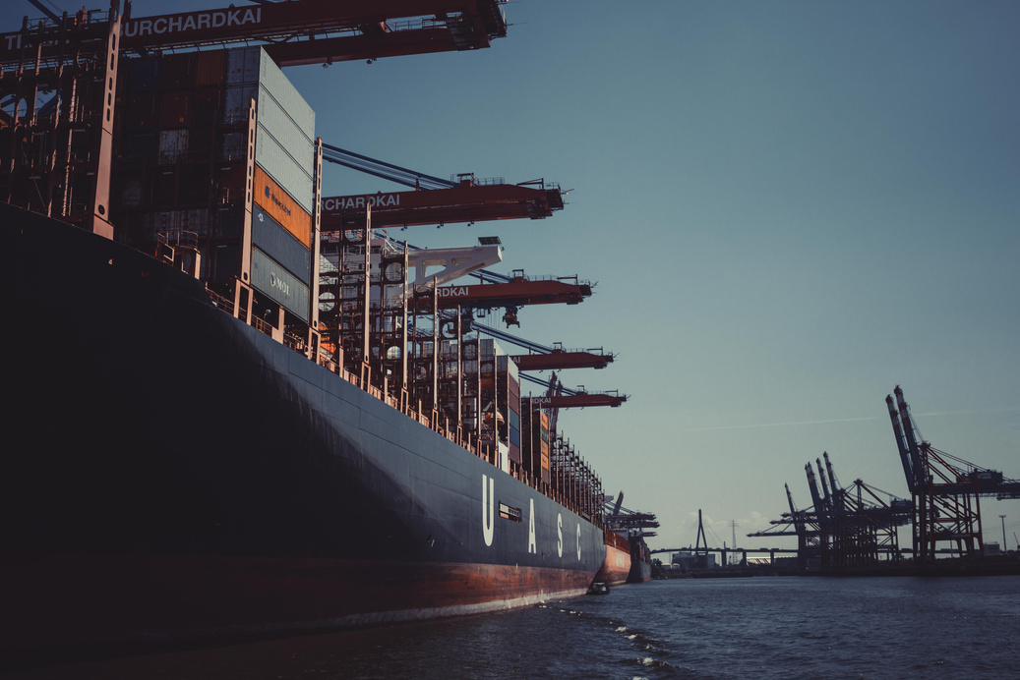


ABOUT PROJECT
BUSINESS QUESTIONS
METHODOLOGY
TOOLS & TECHNOLOGIES
RECOMMENDATIONS
Key
Recommendations
Invest in lower-emission modes (e.g., increase rail and inland waterway usage)
Promote containerization in high-cost, high-emission lanes
Implement seasonal freight management strategies to reduce Q4 congestion
Use emissions data for carbon reporting and transport policy.

Slide 13
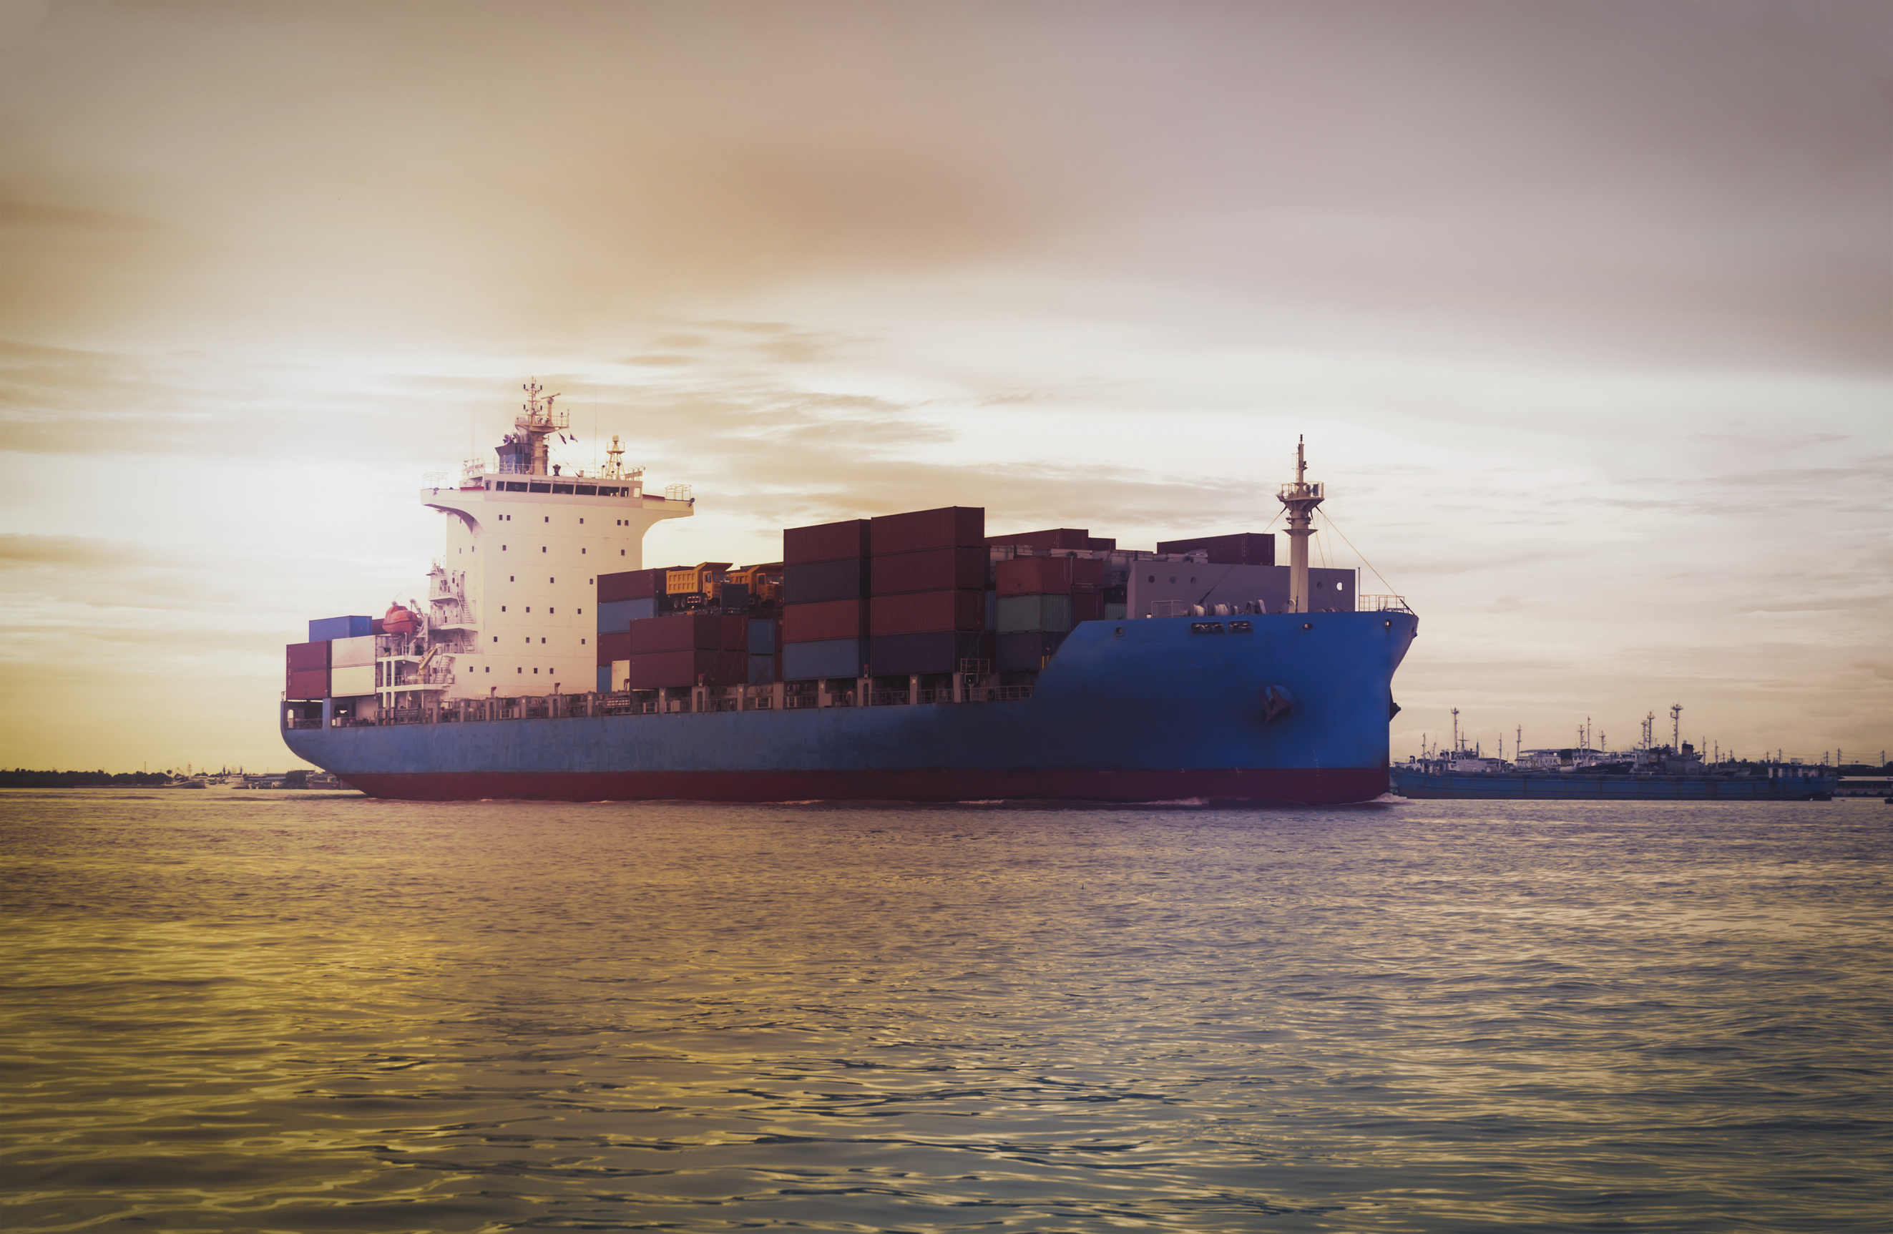
ABOUT PROJECT
BUSINESS QUESTIONS
METHODOLOGY
TOOLS & TECHNOLOGIES
INSIGHTS
Thank
You!

